Slide 1
CSE 2133 - Business Programming with File Processing
The Basics

Slide 2
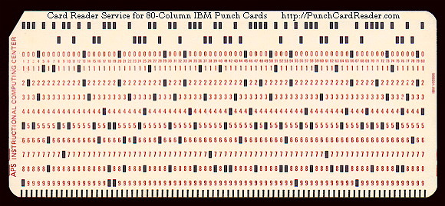
COBOL Coding Form
COBOL has restrictions on which columns can be used for certain purposes
Restrictions came about originally from limitations of punch cards

Slide 3
COBOL Coding Form
The COBOL Coding Form describes these restrictions
Columns 1 – 6: No longer used. Ignored by the compiler
Once used for line numbers, which were utilized by a punch card sorter
Column 7: Used to denote a comment or the continuation of a string literal (something between quotes)

Slide 4
COBOL Coding Form
Columns 8 – 11: “A Margin”
Certain items must begin in this zone
Division Names
Section Names
Paragraph Names
Other items must be fully contained in this zone
Level numbers 01 and 77
File/Sort Descriptor codes

Slide 5
COBOL Coding Form
Columns 12 – 72: “B Margin”
Pretty much everything else
Columns 73 – 80: No longer used. Ignored by the compiler
Once used for program names, which were utilized by a punch card sorter

Slide 6
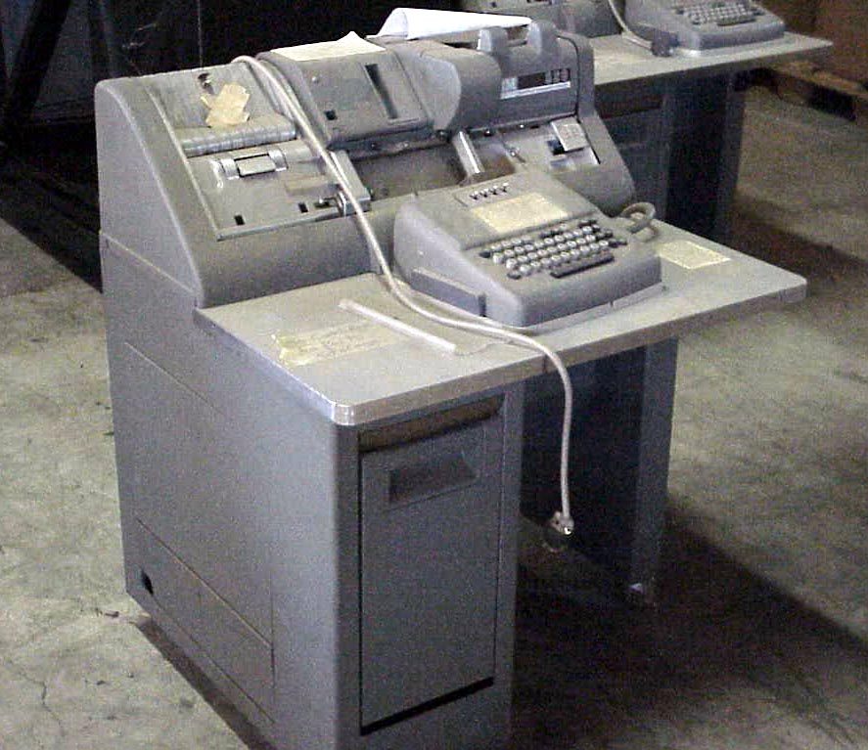
Punch Card Machine

Slide 7
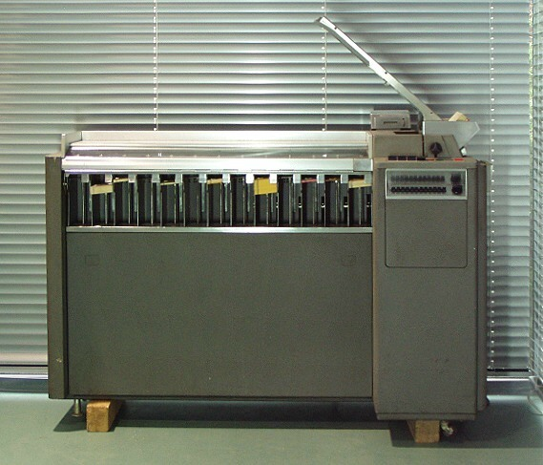
Punch Card Sorter

Slide 8
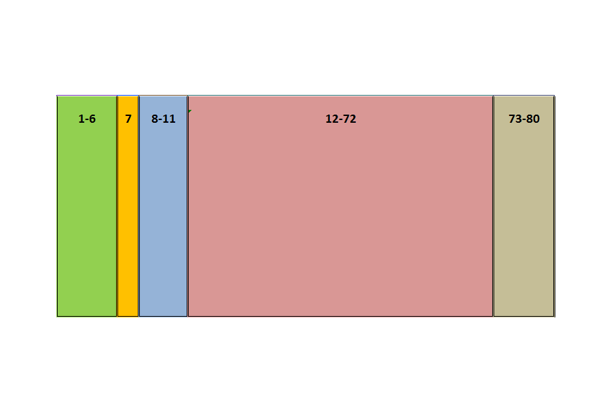
COBOL Coding Form

Slide 9
COBOL Coding Form
Ignored (once for Line Numbers)

Slide 10
COBOL Coding Form
(*) Comments or (-) Continuation

Slide 11
COBOL Coding Form
“A” Margin

Slide 12
COBOL Coding Form
“B” Margin

Slide 13
COBOL Coding Form
Ignored (once for Program Name)

Slide 14
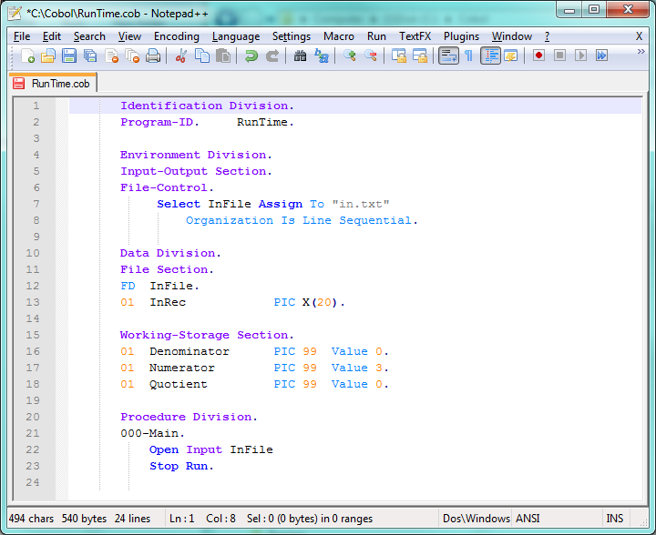
Division Names
Paragraph Names
Section Names
Other “A” Items
Column 8

Slide 15
Column 12

Slide 16
COBOL Program Structure
A COBOL program is divided into Divisions
A Division can consist of 1 or more Sections
Each Section can consist of 1 or more Paragraphs
Paragraphs consist of Sentences
Sentences consist of 1 or more Statements

Slide 17
Some Notes on OpenCOBOL
The code is not case-sensitive
Most COBOL implementations require code to be in uppercase (DISPLAY, OPEN)
Open COBOL does not (display, Display also OK)
There are times where case does matter
Either single or double quotes can be used to enclose strings
Most COBOL implementations only allow single quotes

Slide 18
Tabs in the Source Code
Tabs can be introduced into the .cob file by using the Tab key, or automatically by the editor when it is auto-indenting
Typically a tab is the equivalent of 4 spaces, but the OpenCOBOL translation process converts them to 8 spaces behind the scenes
Will still look like 4 in the .cob file
COBOL has rules on column usage, so tabs are to be avoided

Slide 19
NotePad++ And Tabs
NotePad++ has a setting that will convert any tab into 4 spaces
Click “Settings” on the menu bar
Click “Preferences” on the Settings menu
Click the “Language Menu/Tab Settings” Tab
Check the “Replace by space” box in the Tab Settings section

Slide 20
NotePad++ And Tabs
NotePad++ allows you to replace existing tabs with spaces
Put the cursor at the beginning of the source code
Click “Search” in the menu bar
Click “Replace” in the Search menu
For “Search Mode,” select “Extended”
In the “Find what” box, enter “\t”
In the “Replace with” box enter 4 spaces
Click “Replace All”

Slide 21
Source Code ends in NewLine
A requirement of the MinGW C compiler is that the last line of the source code contains no text
Make sure your text editor shows an empty line at the end of source code

Slide 22
Periods
Periods are required in many places in COBOL code and optional in others
Recommended to not use them unless required
All division, section and paragraph names must end in a period
The last statement in a paragraph must end in a period
Other usages will be noted as needed

Slide 23
User-Defined Names
The rules for developing user-defined names in COBOL (i.e., program name, file names, variables, paragraphs)
Allowable characters
Letters (A-Z)
Digits (0-9)
Dash/Hyphen (-)
Cannot begin or end in dash
Must contain at least 1 letter (except for paragraph name)
Not case sensitive (except for program name)
Length must be < 32
Cannot be a COBOL reserved word

Slide 24
Hello, World!
It has become standard practice to introduce programming languages with a simple “Hello, World” program Identification Division. Program-ID. HelloWorld. Procedure Division. 000-Main. Display "Hello, World!" Stop Run.

Slide 25
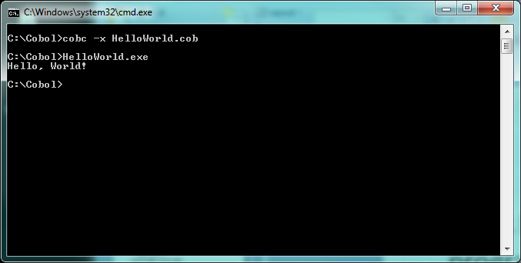
Hello, World!

Slide 26
The Identification Division
All COBOL programs begin with the Identification Division
Has no sections
Only 1 paragraph is still supported, Program-ID
Enables other programs to identify this program
Program name is case-sensitive
Identification Division. Program-ID. Program-Name.

Slide 27
The Identification Division
All COBOL programs begin with the Identification Division
Has no sections
Only 1 paragraph is still supported, Program-ID
Enables other programs to identify this program
Program name is case-sensitive
Identification Division. Program-ID. Program-Name.
Note the periods

Slide 28
The Identification Division
Other Identification Division paragraphs are obsolete (ignored by OpenCOBOL)
Date-Written
Date-Compiled
Author
Installation
Security
Remarks

Slide 29
“If you don't have time to do it right, you better have time to do it over.” -- Unknown

